Slide 1











IEEE NSUT
HACK4DELHI
Pitch Directly to the Government. Build for the Nation.
Team Name :
Members name and Affiliation:
Aashi Gupta
Mritunjay Kumar
The Shadow Brokers
Suraj Arya
Tanishk Tiwari
Cluster Innovation Centre
University of Delhi

Slide 2


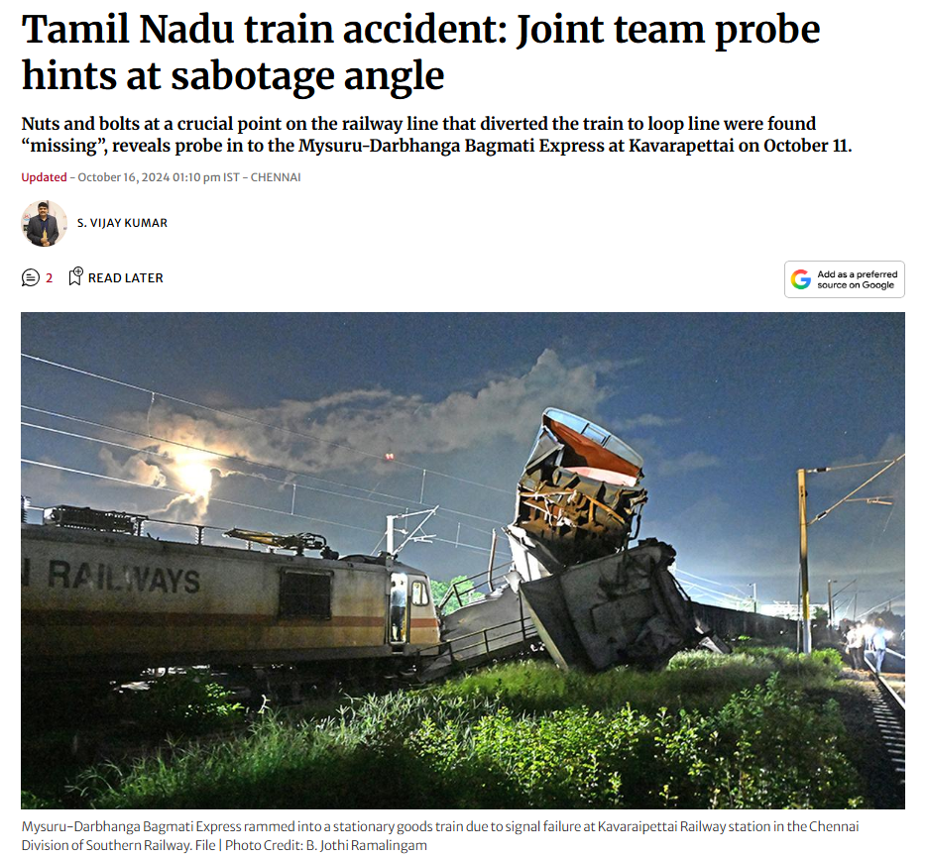
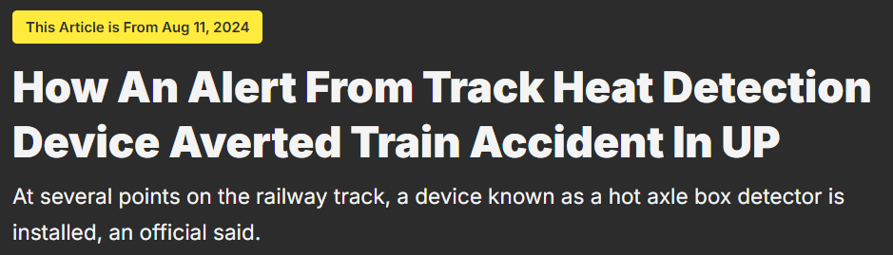
PROBLEM STATEMENT
IEEE NSUT
Railway tracks are critical national infrastructure, yet remain physically exposed to intentional tampering such as rail cutting, bolt/fishplate removal, and track obstruction.
These incidents usually occur in remote or unmanned sections, at night or low-visibility between manual patrol intervals.
Why current systems fail:
Manual patrols are infrequent and human-dependent
CCTV systems are high-power, bandwidth-heavy, and weak at night
Drones provide periodic, weather-dependent monitoring
Track circuits detect faults, not tampering intent
Single-sensor setups cause false alarms from rain, animals, or trains
As a result, tampering is often detected only after a derailment or near-miss, making today’s response reactive instead of preventive.
This Problem Must Be Solved
Safety: Prevent derailments and loss of life
Security: Railway tracks are soft targets for sabotage
Economic Impact: Avoid massive service disruption & repair costs
Scalability: Thousands of kilometers cannot be manually monitored

Slide 3
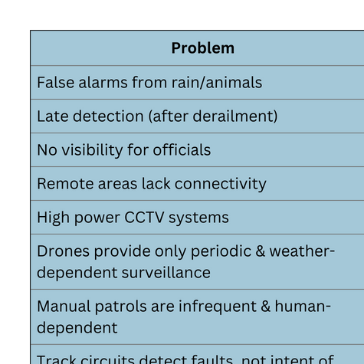
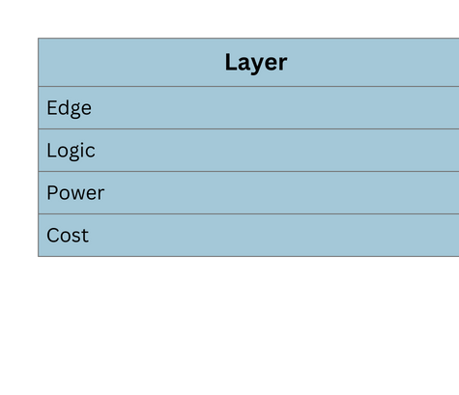
SOLUTION
IEEE NSUT
Decentralized, AI-powered IoT system for real-time detection of intentional track tampering
Detects the act of tampering, not post-damage failure
Designed for remote, low-power, large-scale railway deployment
Track Sensors
(Vibration + Audio + Magnetic + Tilt)
↓
Edge AI (TinyML on ESP32)
• Filters trains/weather
• Detects tool signatures
↓
3-Stage Lock Verification
(Vibration + Audio + Magnetic)
↓
Secure Transmission (MQTT over LoRa / LTE)
↓
Central AI Validation (FastAPI)
↓
Real-Time Alert + Evidence Dashboard
A practical, low-cost AI system that prevents railway sabotage instead of investigating accidents.

Slide 4


ARCHITECTURE
3. Cloud & Processing Layer
MQTT Broker receives events
(Mosquitto / HiveMQ)
↓
Backend API
(Python FastAPI)
Performs multi-sensor AI fusion
Validates tampering confidence
Generates structured alerts
↓
Data storage:
• InfluxDB (sensor data)
• PostgreSQL (alerts)
↓
4. Control Room Layer
React.js dashboard
WebSocket-based live alerts
(React.js + WebSockets)
Displays:
Alert location
Severity
Sensor evidence
Timeline of events
IEEE NSUT
1. Edge Layer (On-Track Node)
(ESP32 + Sensors)
Sensors collect:
• Vibration + Audio + Magnetic + Track Tilt
FFT + TinyML classify:
Normal activity (train, weather)
Abnormal activity (tampering)
Only suspicious events move forward
↓
2. Messaging & Communication Layer
MQTT Publish (QoS-1)
Topic: railway/track_id/data
Reliable delivery using:
QoS Level 1
Local FIFO buffering
Burst transmission after reconnection
↓
Publish–Subscribe Model (MQTT)
Sensor nodes publish data to topics
Backend subscribes to all track events
Decoupled, scalable, fault-tolerant
Time Accuracy
NTP synchronization on ESP32
Timestamps generated at event time, not upload time
Data Integrity
FIFO buffering during network loss
Burst transmission after reconnection
QoS Level 1 ensures alert delivery
Unique message IDs prevent duplicate alerts
Edge-first AI → low latency, low bandwidth
MQTT + buffering → works in remote rail sections
Time-series DB → accurate forensic analysis
WebSocket alerts → instant operational response

Slide 5
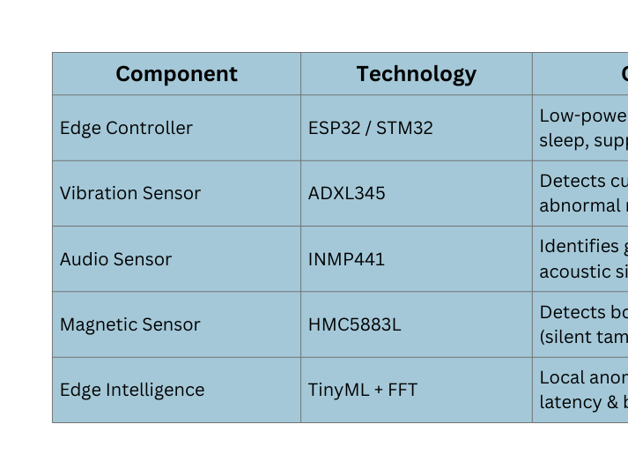
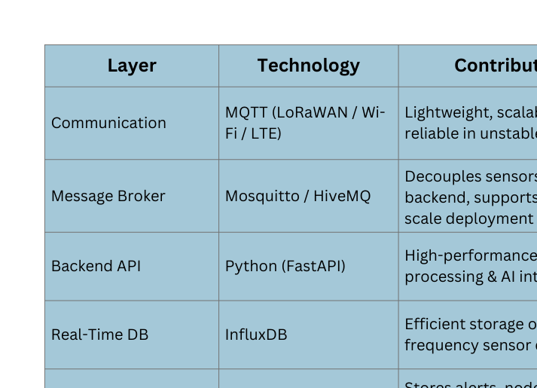
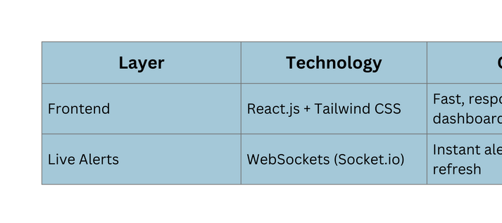
TECHNOLOGY USED
IEEE NSUT
Edge & Sensing Technologies
Communication & Backend Technologies
Visualization & Alerts
The tech stack is optimized for low power, real-time detection, scalability, and deployment in remote railway environments.

Slide 6
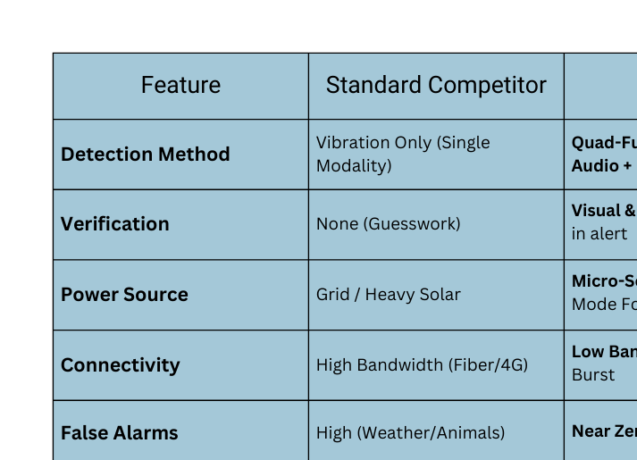
FEATURE/USP
IEEE NSUT
The "False Alarm" Solution
Doesn’t rely on single sensor
Alert is generated if all sensors agree
Actionable Intelligence
Existing dashboards show blinking red dot on map
Our dashboard delivers proof, not just problems
The "Sleepy Sentinel" Power Architecture
CCTV requires massive power and expensive cables.
Our high-power sensors wake up for 10 seconds, when the low-power vibration sensors detect anomaly.
Tamper-Proof" Security
Criminals cut the wires of security systems.
Even if the device is destroyed, the circuit sends a final distress signal.
Magnetic sensor detects if the track components(bolts / fishplates) are removed
Cost-to-Coverage Ratio
Fiber optic sensing (DAS) costs millions per kilometer, while patrolmen are expensive and slow.
Using mass-produced MEMS sensors, per-node cost of ~₹5,200 ($60) achieved.

Slide 7
REFERENCES/LINKS
IEEE NSUT
AI-powered TrackEi™ (L&T Technology Services): High-speed, AI-enabled rail inspection using cameras and laser profiling for real-time defect detection and maintenance planning.
Track Geometry Cars: Sensor-equipped inspection vehicles widely used for automated track measurement (alignment, twist, gauge) without disrupting operations.
Track IQ (Wabtec): Multi-sensor systems (acoustic & condition monitors) deployed globally to detect wheel/track faults, showing industry adoption of sensing-based safety.
Academic sensor+ML works: Machine learning applied for obstacle & crack detection on tracks using camera and IoT sensor data.
IoT-Enabled Railway Track Crack Detection System: Presented at the International Conference on Innovative Computing & Communication, this research integrates IoT sensors along the track to detect cracks and anomalies in real time.
Github: https://github.com/thesurajarya/hack4delhi.git

Slide 8








IEEE NSUT
THANK YOU

